Slide 1


Mercury Helper
What It Can Do For You - May-19-2017 1:24 PM

Slide 2

Get serious . . . about Mercury process automation.
When I first started on this project I was a bit overwhelmed by the number of technologies and processes Mike and David used. To deal with this challenge I strived to automate, simplify and make repeatable Mercury processes.
I like to write things down because if I figure out how to do something once, I won’t to have to figure it out again if I forget it.

Slide 3
Git serious . . . Git batch_files.
Because these scripts can be used on our work machines as well as the servers, I recommend you install the batch_files folder at the commonly used folder across all, viz. c:\mercury.
For example, the command I would use is:
C:\mercury>git clone https://Jonathan17@bitbucket.org/nesmercuryteam/batch_files.git --branch master .\batch_files
I know David likes GitGui, so feel free to Git it, whatever way works for you.

Slide 4
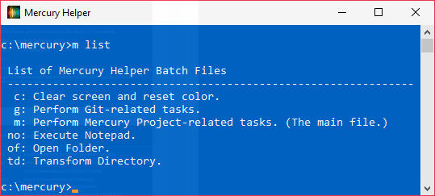
The command line is fun for keyboard junkies.
From the batch_files folder, control drag and drop Mercury Helper.lnk to your desktop.
To see a list of the primary Mercury Helper batch files and their functions, type: C:\>m list

Slide 5
Get help.
To see the available functions for a batch file use the “/?” parameter.
For example, to get help (run these now):
c:\>m /?
c:\td /?
c:\>no /?
I believe good software should usually be predictable. Given that what would you say the command is to use Notepad to edit in the server log file? . . .? . . .? Guesses?

Slide 6
The answer is:
C:\>no log
However, user-defined aliases can be used so a single operation could have any number of aliases. Search on the log tag in the no.bat file for some examples.
All of these do the same as c:\>no log:
c:\>no l, c:\>no lo, c:\>no log, c:\>no serve, c:\>no server,
c:\>no server.log, c:\>no serverlog, c:\>no server_log, c:\>no slog

Slide 7

Some trivial examples to try . . .
C:\>td projects Navigates to the projects directory in DOS.
C:\>of projects Opens the SAME folder as above except in Windows Explorer.
C:\>of cd Opens current DOS directory in Windows Explorer.
C:\>m gen_ver Generate a new Mercury Version Number
C:\>no sw Opens the SystemWidget.js in Notepad.
C:\>g ss Show BitBucket status for all 3 repositories INCLUDES
online repository status comparison. I use this a lot.
C:\>c Clears the screen and resets the prompt color.

Slide 8
Some nontrivial examples to know about . . .
C:\>m wiz/wizp 17 step script that builds a dev/prod WAR file.
C:\>m f5 Compile and refresh Ext JS code. Thanks to David for lots of help with this one.
C:\>m back_up Perform database backup.
C:\>m ldap Start LDAP control panel.
C:\>m sql Connect to MySQL monitor.
C:\>of heatmap Open heatmap image generation location on server.

Slide 9
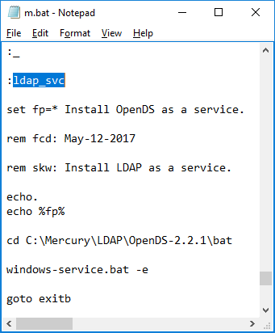
Need more info?
Running C:\>no m
Uses Notepad to open the mercury helper.bat file.
Search for the label, for instance “ladp_svc”,
and you can see the code I ran to install ldap
as a service, which be ran any time by entering
c:\>m ldap_svc

Slide 10
Team Sharing
No one’s obligated to use any of this stuff. I just wanted to share it and make it available to the other team members in found it helpful.
A cool thing about this architecture is that it is scalable in the sense that if you want some new script feature all you need to do is add a unique label and a code block and you are up and running.

Slide 11

The End

